Slide 1
Midterm Proposal :
Portfolio Website
Gabi Costa
Pinterest Link: (4) Pinterest

Slide 2
Skills Covered:
Skills To Learn:
position
spacing
color
transparency
import fonts
import images
transformations
hover
add sound effects
importing videos
link email

Slide 3
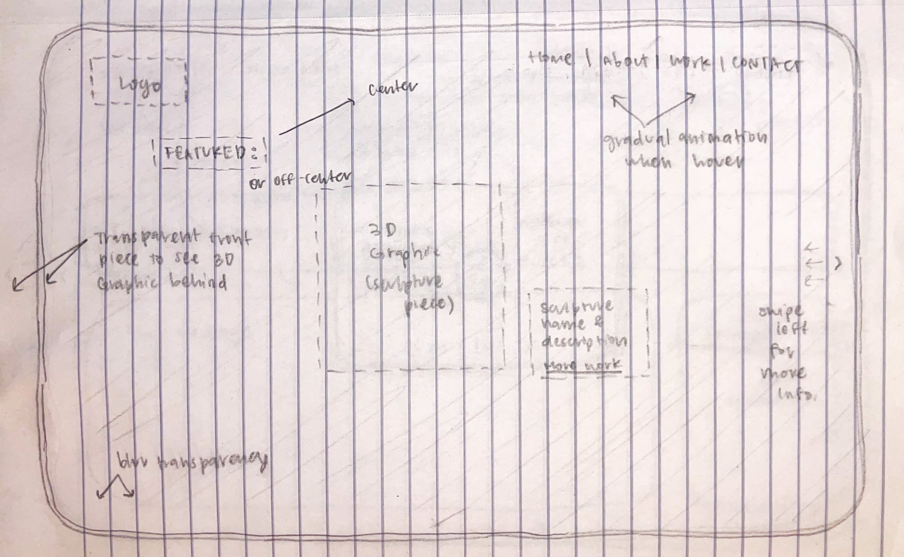
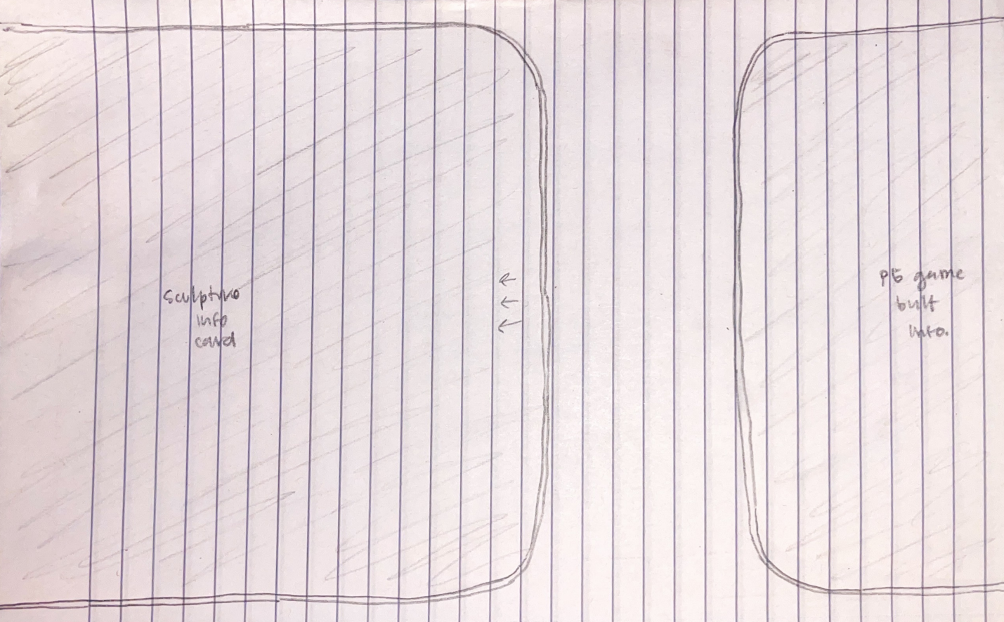
Home Page -
Transparent cards w/ blur
Toggle b/w cards
Name logo in top left
Featured work
Menu bar at top right

Slide 4
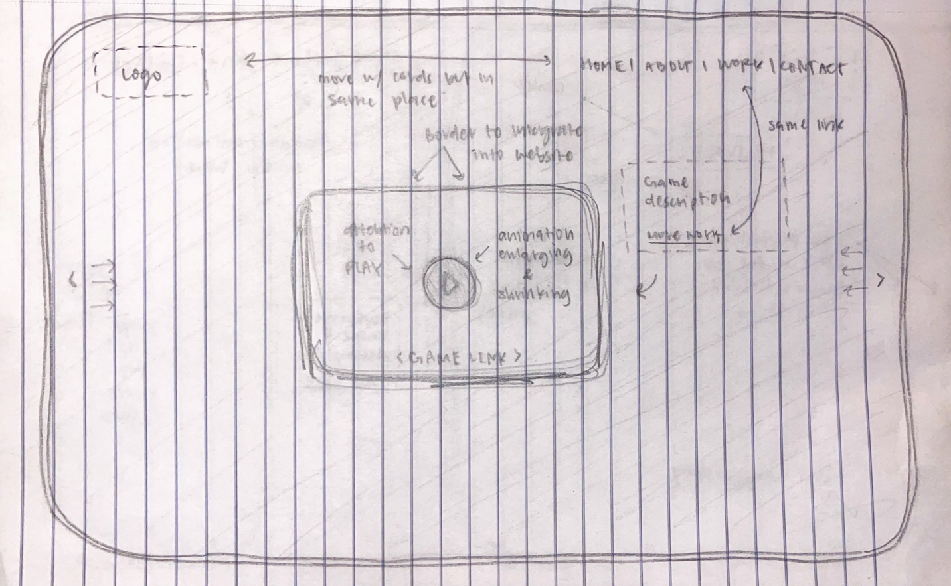
Work Slide -
Video link
Game link
More work link

Slide 5
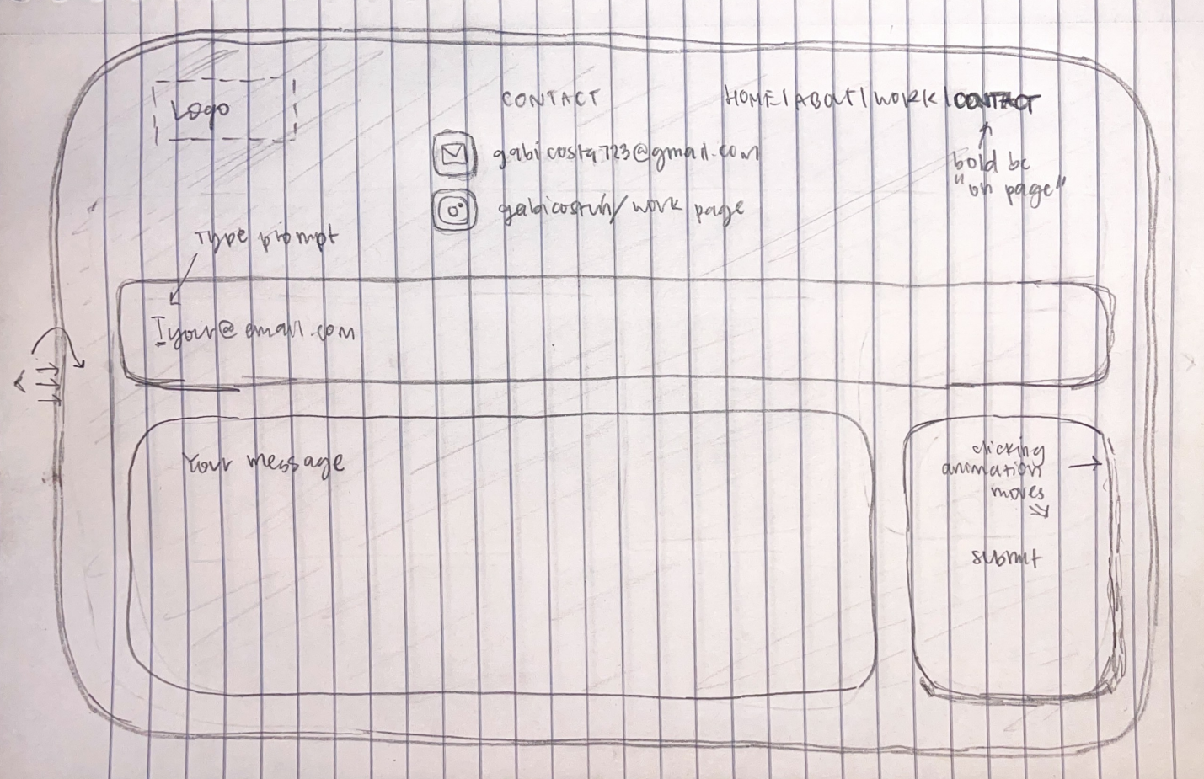
Contact Me Page
Bold menu bar
Email/socials link
Skills to learn:
Connect email to prompt/email submission

